Slide 1
Assignment Problem
(Hungarian Assignment Method)
(HAM)

Slide 2
Assignment Problem
Time taken (in Minutes) by workers
Workers | Jobs
 | A | B | C | D
1 | 45 | 40 | 51 | 67
2 | 57 | 42 | 63 | 55
3 | 49 | 52 | 48 | 64
4 | 41 | 45 | 60 | 55

Slide 3
Reduced Cost Table -1 (Consider the least element in every row and subtract this element from all the elements of its respective row including the element itself.)
Time taken (in Minutes) by workers
Workers | Jobs
 | A | B | C | D
1 | 5 | 0 | 11 | 27
2 | 15 | 0 | 21 | 13
3 | 1 | 4 | 0 | 16
4 | 0 | 4 | 19 | 14

Slide 4
Reduced Cost Table -2 (Consider the least element in every column and subtract this element from all the elements of its respective column including the element itself.)
Time taken (in Minutes) by workers
Workers | Jobs
 | A | B | C | D
1 | 5 | 0 | 11 | 14
2 | 15 | 0 | 21 | 0
3 | 1 | 4 | 0 | 3
4 | 0 | 4 | 19 | 1

Slide 5
Optimal Solution (Consider the single in zero in every row and column)
Time taken (in Minutes) by workers
Workers | Jobs
 | A | B | C | D
1 | 5 | 0 | 11 | 14
2 | 15 | 0 | 21 | 0
3 | 1 | 4 | 0 | 3
4 | 0 | 4 | 19 | 1
Workers | Jobs | Time
1 | B | 40
2 | D | 55
3 | C | 48
4 | A | 41
Total Time |  | 184 Minutes

Slide 6
Machinist | Jobs
 | 1 | 2 | 3 | 4 | 5
A | 10 | 3 | 3 | 2 | 8
B | 9 | 7 | 8 | 2 | 7
C | 7 | 5 | 6 | 2 | 4
D | 3 | 5 | 8 | 2 | 4
E | 9 | 10 | 9 | 6 | 10

Slide 7
Reduced Table 1
Machinist | Jobs
 | 1 | 2 | 3 | 4 | 5
A | 8 | 1 | 1 | 0 | 6
B | 7 | 5 | 6 | 0 | 5
C | 5 | 3 | 4 | 0 | 2
D | 1 | 3 | 6 | 0 | 2
E | 3 | 4 | 3 | 0 | 4

Slide 8
Reduced Table 2
Machinist | Jobs
 | 1 | 2 | 3 | 4 | 5
A | 7 | 0 | 0 | 0 | 4
B | 6 | 4 | 5 | 0 | 3
C | 4 | 2 | 3 | 0 | 0
D | 0 | 2 | 5 | 0 | 0
E | 2 | 3 | 2 | 0 | 2
Since, no. Of lines drawn ≠ no. Of rows= No. Of Columns, this is not an optimal Solution. The solution needs to be revised.

Slide 9
Reduced table 3
Machinist | Jobs
 | 1 | 2 | 3 | 4 | 5
A | 9 | 0 | 0 | 2 | 6
B | 6 | 2 | 3 | 0 | 3
C | 4 | 0 | 1 | 0 | 0
D | 0 | 0 | 3 | 0 | 0
E | 2 | 1 | 0 | 0 | 2
Since no. Of lines drawn = no. Of rows= no. Of columns, this is the optimal solution

Slide 10
Optimal solution
Machinist | Jobs
 | 1 | 2 | 3 | 4 | 5
A | 9 | 0 | 0 | 2 | 6
B | 6 | 2 | 3 | 0 | 3
C | 4 | 0 | 1 | 0 | 0
D | 0 | 0 | 3 | 0 | 0
E | 2 | 1 | 0 | 0 | 2
Machinist | Jobs | Cost (Rs.)
B | 4 | 2
E | 3 | 9
A | 2 | 3
C | 5 | 4
D | 1 | 3
Total cost |  | 21
Solution

Slide 11
Q.
Person | Jobs
 | J1 | J2 | J3 | J4 | J5
P1 | 27 | 18 | M | 20 | 21
P2 | 31 | 24 | 21 | 12 | 17
P3 | 20 | 17 | 20 | M | 16
P4 | 22 | 28 | 20 | 16 | 27
P5(Dummy) | 0 | 0 | 0 | 0 | 0

Slide 12
Solution: Reduced Table 1: (Row Reduction)
Person | Jobs
 | J1 | J2 | J3 | J4 | J5
P1 | 9 | 0 | M | 2 | 3
P2 | 19 | 12 | 9 | 0 | 5
P3 | 4 | 1 | 4 | M | 0
P4 | 6 | 12 | 4 | 0 | 11
P5(Dummy) | 0 | 0 | 0 | 0 | 0
Since, the least element is zero in every column, we will get the same table on column reduction.
Also, this is not an optimal solution, because no. Of lines drawn ≠ no. Of rows/ columns. So, we need to revise the solution.

Slide 13
Revised Solution: Reduced Table 2:
Person | Jobs
 | J1 | J2 | J3 | J4 | J5
P1 | 5 | 0 | M | 2 | 3
P2 | 15 | 12 | 5 | 0 | 5
P3 | 0 | 1 | 0 | M | 0
P4 | 2 | 12 | 0 | 0 | 11
P5(Dummy) | 0 | 4 | 0 | 4 | 4
i)select least uncovered value; subtract it from every uncovered value;
ii) Add this least uncovered value to each cell value at intersection of lines
iii) Let the covered elements remain unchanged.
Since, no. Of lines drawn = No. Of rows/ columns, this is an optimal solution

Slide 14
Solution:
Person | Jobs
 | J1 | J2 | J3 | J4 | J5
P1 | 5 | 0 | M | 2 | 3
P2 | 15 | 12 | 5 | 0 | 5
P3 | 0 | 1 | 0 | M | 0
P4 | 2 | 12 | 0 | 0 | 11
P5(Dummy) | 0 | 4 | 0 | 4 | 4
Person | Jobs | cost
P1 | J2
P2 | J4
P3 | J5
P4 | J3
P5(Dummy) | J1
Person | Jobs | cost
P1 | J2 | 18
P2 | J4 | 12
P3 | J5 | 16
P4 | J3 | 20
P5(Dummy) | J1 | 0
Total Cost |  | 66

Slide 15
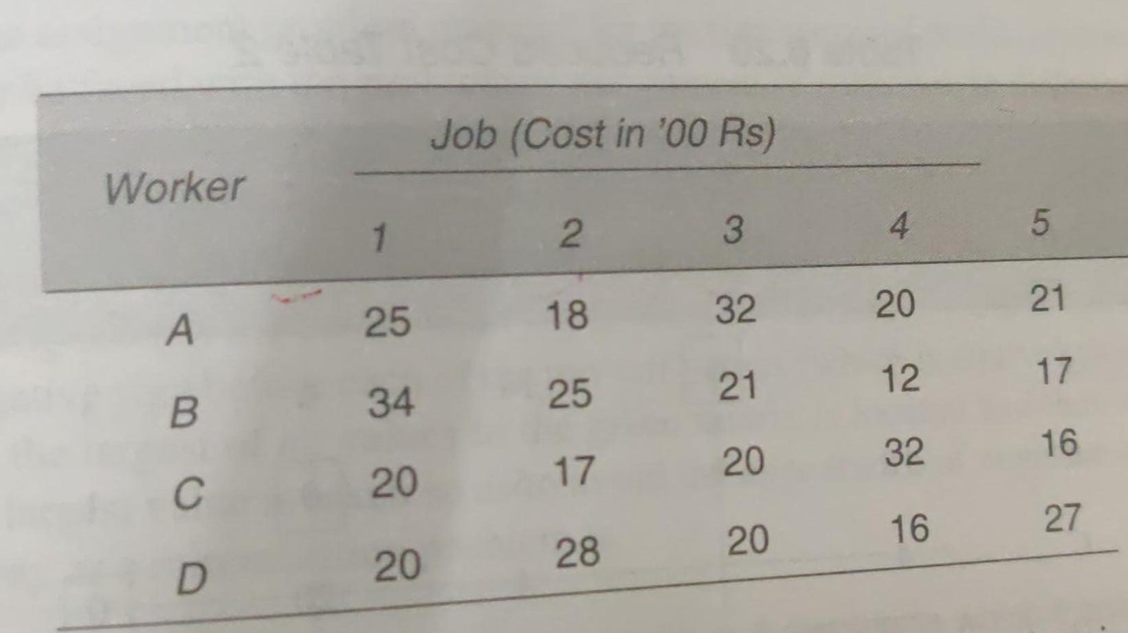

Slide 16
 | Jobs (Cost in Rupees)
 | 1 | 2 | 3 | 4 | 5
A | 25 | 18 | 32 | 20 | 21
B | 34 | 25 | 21 | 12 | 17
C | 20 | 17 | 20 | 32 | 16
D | 20 | 28 | 20 | 16 | 27
E(DUMMY) | 0 | 0 | 0 | 0 | 0
Reduced Table 1
(Row reduction)
 | Jobs (Cost in Rupees)
 | 1 | 2 | 3 | 4 | 5
A | 7 | 0 | 14 | 2 | 3
B | 22 | 13 | 9 | 0 | 5
C | 4 | 3 | 4 | 16 | 0
D | 4 | 12 | 4 | 0 | 11
E(DUMMY) | 0 | 0 | 0 | 0 | 0

Slide 17
 | Jobs (Cost in Rupees)
 | 1 | 2 | 3 | 4 | 5
A | 7 | 0 | 14 | 2 | 3
B | 22 | 13 | 9 | 0 | 5
C | 4 | 3 | 4 | 16 | 0
D | 4 | 12 | 4 | 0 | 11
E(DUMMY) | 0 | 0 | 0 | 0 | 0
Since, no. Of lines drawn ≠ no. Of rows/ columns, this is not an optimal solution and therefore, the solution needs to be revised.
 | Revised Solution
 | Jobs (Cost in Rupees)
 | 1 | 2 | 3 | 4 | 5
A | 7 | 0 | 14 | 6 | 3
B | 18 | 9 | 5 | 0 | 1
C | 4 | 3 | 4 | 20 | 0
D | 0 | 8 | 0 | 0 | 7
E(DUMMY) | 0 | 0 | 0 | 4 | 0
Since, no. Of lines drawn = mo. Of rows/ column, this is the optimal solution

Slide 18
 | Revised Solution
 | Jobs (Cost in Rupees)
 | 1 | 2 | 3 | 4 | 5
A | 7 | 0 | 14 | 6 | 3
B | 18 | 9 | 5 | 0 | 1
C | 4 | 3 | 4 | 20 | 0
D | 0 | 8 | 0 | 0 | 7
E(DUMMY) | 0 | 0 | 0 | 4 | 0
Multiple Optimal Solution
Person | Job | Cost
A | 2 | 18
B | 4 | 12
C | 5 | 16
D | 1 | 20
E | 3 | 0
Total Cost |  | 66
Person | Job | Cost
A | 2 | 18
B | 4 | 12
C | 5 | 16
D | 3 | 20
E | 1 | 0
Total Cost |  | 66

Slide 19
After Row and Column Reduction
Step 2: Cover all zeros by least number of horizontal/ vertical lines
Step 3: If number of lines = n, where n is no. of rows= no. of columns;
If number of lines ≠ n move to step 4 else make adjustment:
Step 4:
i)select least uncovered value; subtract it from every uncovered value;
ii) Add this least uncovered value to each cell value at intersection of lines
iii) Let the covered elements remain unchanged.
Again cover zeros with lines to find if you could go to 4.

Slide 20
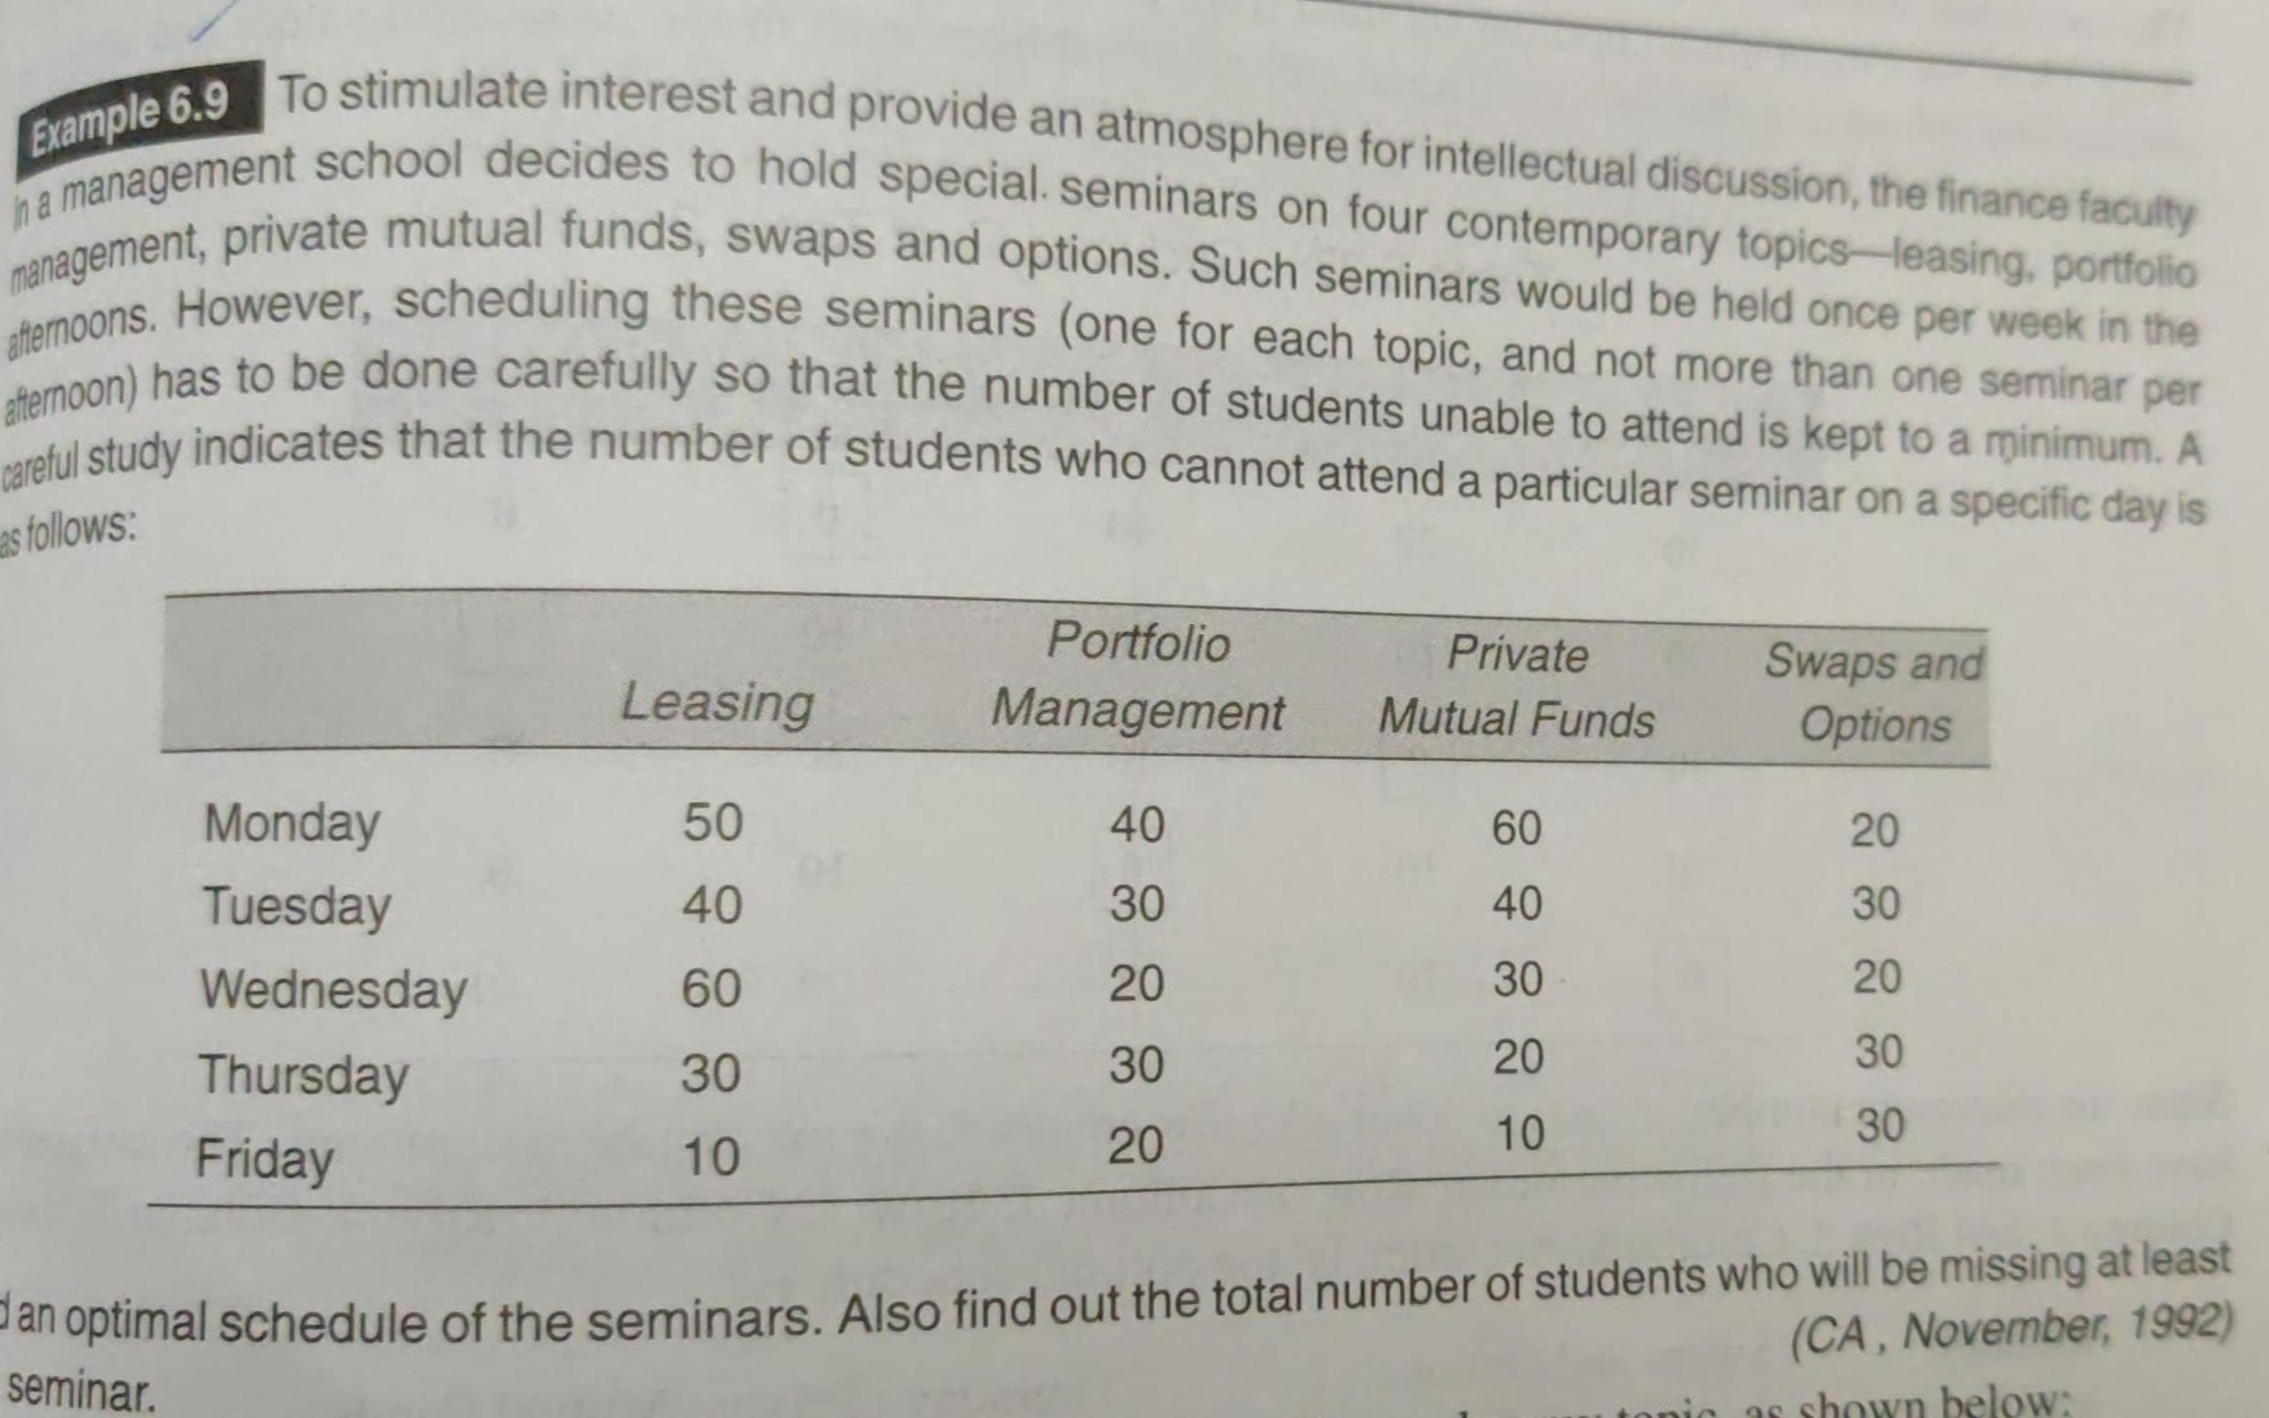

Slide 21
 | Leasing | PM | PMF | S&O | Dummy
Monday | 50 | 40 | 60 | 20 | 0
Tuesday | 40 | 30 | 40 | 30 | 0
Wednesday | 60 | 20 | 30 | 20 | 0
Thursday | 30 | 30 | 20 | 30 | 0
Friday | 10 | 20 | 10 | 30 | 0
Reduced Table 1
 | Leasing | PM | PMF | S&O | Dummy
Monday | 40 | 20 | 50 | 0 | 0
Tuesday | 30 | 10 | 30 | 10 | 0
Wednesday | 50 | 0 | 20 | 0 | 0
Thursday | 20 | 10 | 10 | 10 | 0
Friday | 0 | 0 | 0 | 10 | 0
Since, no. Of lines drawn ≠No. Of rows/ columns, this is not an optimal solution. Thus, we need to revise the solution.

Slide 22
Revising Solution:
Step 1: Identify least uncovered element and subtract it from all uncovered elements including the element itself.
Step 2: Add this least uncovered element to the cell value where lines are intersecting.

Slide 23
Reduced Table 2 (Revise solution)
 | Leasing | PM | PMF | S&O | Dummy
Monday | 30 | 20 | 40 | 0 | 0
Tuesday | 20 | 10 | 20 | 10 | 0
Wednesday | 40 | 0 | 10 | 0 | 0
Thursday | 10 | 10 | 0 | 10 | 0
Friday | 0 | 10 | 0 | 20 | 10
 | Leasing | PM | PMF | S&O | Dummy
Monday | 30 | 20 | 40 | 0 | 0
Tuesday | 20 | 10 | 20 | 10 | 0
Wednesday | 40 | 0 | 10 | 0 | 0
Thursday | 10 | 10 | 0 | 10 | 0
Friday | 0 | 10 | 0 | 20 | 10
Day | Seminar | Absentism
Monday | S&O | 20
Tuesday | Dummy | 0
Wednesday | PM | 20
Thursday | PMF | 20
Friday | Leasing | 10
Total Absent Students |  | 70

Slide 24
A solicitor’s firm employs typists on hourly piece-rate basis for their daily work. There are 5 typists and their charges and speed are different. According to an earlier understanding, only 1 job is given to 1 typist and the typist is paid for a full hour even when he works for a fraction of an hour. Find the least cost allocation for the following data:
Typist | Rate/hr (Rs) | No. of pages typed/hr | Job | No. of pages
A | 5 | 12 | P | 199
B | 6 | 14 | Q | 175
C | 3 | 8 | R | 145
D | 4 | 10 | S | 298
E | 4 | 11 | T | 178
Typist | Jobs (Cost in Rs.)
 | P | Q | R | S | T
A | 85 | 75 | 65 | 125 | 75
B | 90 | 78 | 66 | 132 | 78
C | 75 | 66 | 57 | 114 | 69
D | 80 | 72 | 60 | 120 | 72
E | 76 | 64 | 56 | 112 | 68

Slide 25
In a multi-storied building, there are 5 rooms to be assigned to 5 managers. Each room has its own advantages and disadvantages. They are all of different shapes and sizes. Each of the 5 managers was asked to rank their preferences amongst the rooms. Their preferences are recorded in the below table:
Manager
M₁ | M₂ | M₃ | M₄ | M₅
302 | 302 | 303 | 302 | 301
303 | 304 | 301 | 305 | 302
304 | 305 | 304 | 304 | 304
 | 301 | 305 | 303
 |  | 302
Most of the managers did not list all the 5 rooms since they were not satisfied with some of these rooms. Assuming that their preferences can be quantified in numbers, find out as to which manager should be assigned to which room so that their total preference ranking is minimum
 | Manager
 | M₁ | M₂ | M₃ | M₄ | M₅
301 | M | 4 | 2 | M | 1
302 | 1 | 1 | 5 | 1 | 2
303 | 2 | M | 1 | 4 | M
304 | 3 | 2 | 3 | 3 | 3
305 | M | 3 | 4 | 2 | M

Slide 26
A firm produces 4 products. There are 4 operators capable of producing any of these 4 products. The firm records 8 hrs a day and allows 30 min for lunch. The processing time in minutes and profit for each of the products is given below. Find the optimal assignment of products to operators.
Total Processing Time available in a Day
= 8 hrs – 30 mins
= 7hrs 30 Mins
=450 mins
Operator | A | B | C | D
1 | 15 | 9 | 10 | 6
2 | 10 | 6 | 9 | 6
3 | 25 | 15 | 15 | 9
4 | 15 | 9 | 10 | 10
Profit/Unit | 8 | 6 | 5 | 4
Profit Matrix
Operator | A | B | C | D
1 | 240 | 300 | 225 | 300
2 | 360 | 450 | 250 | 300
3 | 144 | 180 | 150 | 200
4 | 240 | 300 | 225 | 180
Operator 1 – Job A
Profit = 450/15 = 30 units* 8= Rs. 240

Slide 27
A company has 4 sales representatives who are to be assigned 4 sales territories. The monthly sales increase estimated for each sale representatives are shown below. Suggest optimal assignment so as to maximize total sales per month.
Sales Representatives | Sales Territories I II III IV
A | 200 | 150 | 170 | 220
B | 160 | 120 | 150 | 140
C | 190 | 195 | 190 | 200
D | 180 | 175 | 160 | 190
If for certain reasons, sales representative B cannot be assigned to sales territory III, will the optimal assignment schedule be different? If so, find that schedule and its effect on sales.
Salesman | Territory | Sales
A | IV | 220
B | I | 160
C | III | 190
D | II | 175
Total |  | 745
Salesman | Territory | Sales
A | IV | 220
B | III | 150
C | II | 195
D | I | 180
Total |  | 745

Slide 28
An airline, operating 7 days a week, has given the following schedule of its flights between New Delhi and Mumbai. The crews should have a minimum of 5 hours Layover time between the flights. Obtain the pairing of flights that minimizes layover time away from home. For any given pairing, the crew will be based at the city that results in the smallest layover.
New Delhi-Mumbai Mumbai-New Delhi
Flight No. | Departure | Arrival | Flight No. | Departure | Arrival
101 | 5 A.M. | 7 A.M. | 201 | 7 A.M. | 9 A.M.
102 | 7 A.M. | 9 A.M. | 202 | 8 A.M. | 10 A.M.
103 | 1 P.M. | 3 P.M. | 203 | 1 P.M. | 3 P.M.
104 | 7 P.M. | 9 P.M. | 204 | 6 P.M. | 8 P.M.

Slide 29
New Delhi-Mumbai Mumbai-New Delhi
Flight No. | Departure | Arrival | Flight No. | Departure | Arrival
101 | 5 A.M. | 7 A.M. | 201 | 7 A.M. | 9 A.M.
102 | 7 A.M. | 9 A.M. | 202 | 8 A.M. | 10 A.M.
103 | 1 P.M. | 3 P.M. | 203 | 1 P.M. | 3 P.M.
104 | 7 P.M. | 9 P.M. | 204 | 6 P.M. | 8 P.M.
Crew Based At New Delhi*
Flight No. | 201 | 202 | 203 | 204
101 | 24 | 25 | 6 | 11
102 | 22 | 23 | 28 | 9
103 | 16 | 17 | 22 | 27
104 | 10 | 11 | 16 | 21
Crew Based At Mumbai
Flight No. | 201 | 202 | 203 | 204
101 | 20 | 19 | 14 | 9
102 | 22 | 21 | 16 | 11
103 | 28 | 27 | 22 | 17
104 | 10 | 9 | 28 | 23

Slide 30
Minimum Layover Time
Flight No. | 201 | 202 | 203 | 204
101 | 20 | 19 | 6* | 9
102 | 22* | 21 | 16 | 9
103 | 16* | 17* | 22* | 17
104 | 10* | 9 | 16* | 21*

